Slide 1
Kahoot!
Valerie Hyder
ITEC 7445
Dr. Larkin
July 11, 2016
Emerging Technology Presentation

Slide 2
What is Kahoot?
A free game based classroom response system.
Ask questions that motivate students to participate.
Create quizzes, surveys, or discussions.
Photo source: GetKahoot.com

Slide 3
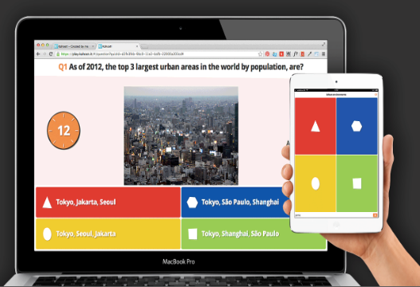
Purpose of Kahoot!
To maintain student engagement in formative assessment using a game based interface.
Students answer questions in real time while competing against each other.
Photo source: GetKahoot.com

Slide 4
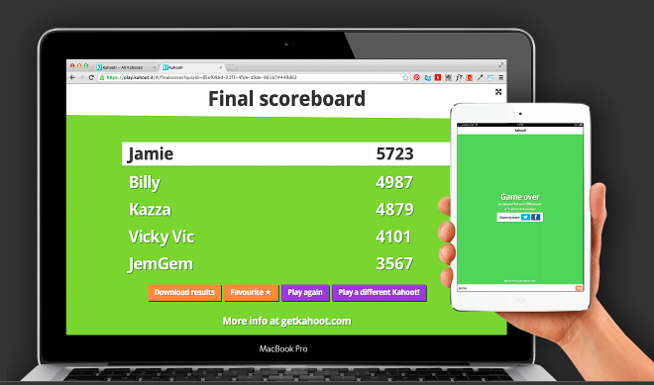
Purpose of Kahoot!
Students try to reach the top of the leaderboard.
Teachers facilitate discussion as students answer questions.
Photo source: GetKahoot.com

Slide 5
Purpose of Kahoot
Kahoot uses a game-based learning approach to inspire creation and research in students. Its game-based system is very entertaining unlike other traditional quiz procedures.

Slide 6
Bartow County’s Vision
“The Bartow County School System is committed to providing quality instruction and excellent educational experiences while insuring academic achievement through technology for the students we serve.”

Slide 7
Adairsville Middle School’s Vision
“Equitable access for students and staff to innovative technology resources, such as internet resources, state-of-the-art computer hardware, digital content based curriculum programs must be provided and maintained in order to meet system goals.”

Slide 8
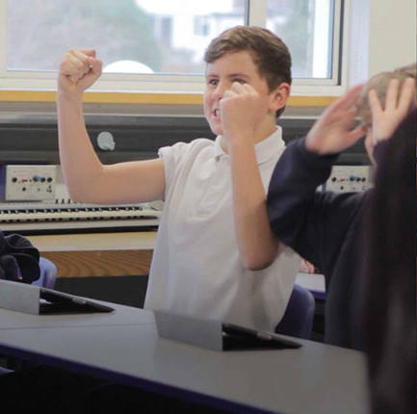
How does Kahoot support Adairsville Middle School’s Vision?
Kahoot is easy to use for all types of learners so equitable access is easy to achieve.
Academic achievement becomes fun for students as they try to reach the top of the leaderboard
Photo source: GetKahoot.com

Slide 9
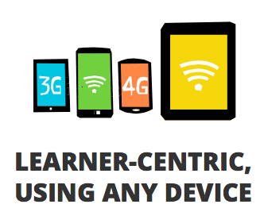
Age and Grade level Range
Engaging for Kindergarten through 12th grade
All students participating need a device with a web browser.
Laptop
Tablet
Smart phone
Photo source: GetKahoot.com

Slide 10
Strategies for equitable access
Students can participate using any device with a web browser.
All students at Adairsville Middle School have a school issued MacBook Air, so all students are able to participate.
Easy to use interface makes participation easy for all types of students at all ages.

Slide 11
Equipment/software needed
Kahoot is a free web based tool
Students do not need a personal account
Internet connection required
Device with a web browser
Photo source: GetKahoot.com

Slide 12
Technical support
Bartow County provides schools with a technology coach to help with laptop and internet connection issues.
Kahoot provides tutorial videos and a help and support section on their website:
Tutorial video
Kahoot FAQ

Slide 13
Limitations
Must have internet connection to use.
Kahoot is only useful in a group setting, so at-home, independent use is not beneficial.
Unless students are creating their own Kahoots for future collaborative use.

Slide 14
Cost
Kahoot is absolutely free to use!
Adairsville Middle has already implemented a 1:1 model so no additional hardware is needed.
If an issue does arise where a student does not have a laptop, they can use their personal device (smart phone or tablet).

Slide 15
Funding
The Bartow County School system has funds in place for continuing implementation of the 1:1 laptop initiative in all schools.
Adairsville Middle is beginning our fourth year of 1:1 implementation, so no additional funds are currently needed to use Kahoot.
In the future, Title I funds could be used if needed.

Slide 16
Usage by teachers
Meeting Content standards
Create Kahoots based specifically on content standards.
Browse through thousands of pre-made Kahoots that address specific needs.
Save and edit pre-made Kahoots.

Slide 17
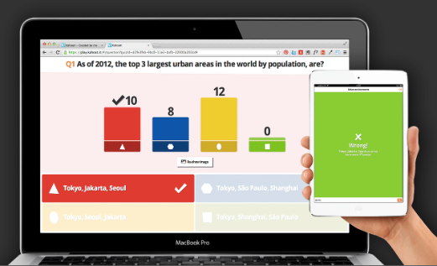
Usage by teachers
Promotes learning goals
Engages students in a variety of question types.
Collaborative in nature.
Provides immediate feedback
See common answers
Address misconceptions
Photo source: GetKahoot.com

Slide 18
Usage By Teachers Continued
Differentiation/Diversity
Students can create their own Kahoots based on a specific, teacher-assigned standard.
Students can work independently or as a team.
Teachers can create quick assessments for individual students to take for data collection.
Promotes Communication
Teachers can facilitate discussion while a quiz is being conducted

Slide 19
Learning by students
Promotes learner centered strategies
Students take control of their learning.
Game based format to encourage participation.
Catchy music plays during game to keep students entertained/engaged.
Promotes authentic learning
Gives immediate feedback and shows correct answers so students can learn from their mistakes.

Slide 20
Learning by students Continued
Higher order thinking
Teachers choose questions so higher order questioning is easy to integrate.
Timer can be adjusted to give students maximum time to think critically before answering.
Collaborative learning
Students can discuss their answers in teams before selecting an answer.
Students can work together to create their own Kahoots.

Slide 21
Local and global Communication
Local
Students can communicate with one another in class while participating in quizzes and discussions.
Students collaborate while working in teams to create their own Kahoots.

Slide 22
Local and Global Communication
Global
View Kahoots from around the world.
Save and edit them to meet specific needs.
Find users that you like and “favorite” them so you can see all of their Kahoots.
Use screen sharing to join classrooms.

Slide 23
Plan for implementation
Professional Learning
Teachers can learn to use Kahoot during a weekly grade level meeting.
Introduce Kahoot to teachers by using an actual Kahoot quiz to gain their attention.
Show teachers tutorial videos and FAQ’s.

Slide 24
Plan for implementation
Sustaining the technology
Check in with teachers periodically to see how implementation is going.
Offer new ways to use Kahoot within the classroom:
Discussions
Surveys
Student-made Kahoots

Slide 25
Research available?
There is little research available, however it has been mentioned on blogs around the world.
Rank 81 on “Top 100 Tools for Learning 2014”
Matt Miller, of “Ditch that textbook” blog, says, “My students begged for it almost every day” and “If you haven’t heard of it, it could be your new favorite digital tool of the year…”
Arctic Start Up, states, “ Kahoot is seeing more than 900,000 unique new players per week and now reaching more than 12 million unique students.”

Slide 26
Reflection: What did you learn?
After using Kahoot in my classroom several times, it is clear that it is a great tool to maintain student engagement.
Students want to be at the top of the leaderboard and beg to play again if we have time. Of course I say yes because they are seeing the content again which is helping them learn.
Being able to search through thousands of Kahoots made by other teachers is often a huge time saver and makes my life so much easier!

Slide 27
Reflection: Strengthen practice?
I have had the chance to refresh some of my colleagues on how to use Kahoot in their classrooms, and showing new teachers how to use Kahoot in their classrooms. I have also been able to assist teachers in editing pre-made Kahoots to meet their specific needs. Hearing about their success in using it makes me feel like I am reaching my goal of becoming a technology coach.
Implementing this tool in my classroom and teaching others to use it has made me realize how much of a positive impact technology integration has on students in the classroom.

Slide 28
References
Anderson, G. (2014). Norway’s kahoot is an edtech rocket with 900,000 unique new players last week. Arctic Start Up. Retrieved from http://arcticstartup.com/2014/10/27/norways-kahoot-is-an-edtech-rocket-with-900000-signups-last-week
Baharti, P. (2014) How kahoot can help teachers to engage students. Retrieved from http://edtechreview.in/news/1490-how-kahoot-can-help-teachers-to-engage-students
Hart, J. (2014). Top 100 tools for learning 2014. Retrieved from http://c4lpt.co.uk/top100tools/kahoot/
Miller, M. (2014). 10 ways to electrify class with kahoot. Ditch that textbook. Retrieved from http://ditchthattextbook.com/2014/08/28/10-ways-to-electrify-class-with-kahoot/

