Slide 1
Data Overview For Adairsville Middle School
Intended For: AMS 8th Grade Teachers & Administrators
By: Valerie Hyder, 8th Grade Teacher
11/11/17

Slide 2
Purpose
The purpose of this data overview is to discuss the Georgia Milestones scores of the 8th grade students for the past three years at Adairsville Middle School (2015 – 2017). We will compare Adairsville’s 8th grade Milestones results to Bartow County and to the state of Georgia, to determine strengths and weaknesses.
We will then look more specifically at Social Studies.
Determining our strengths and weaknesses will help improve our student learning.

Slide 3
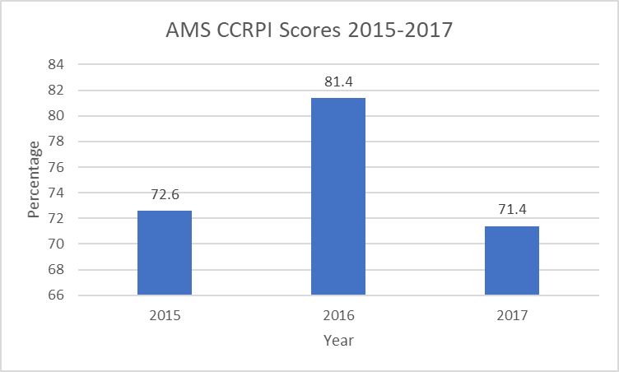
Adairsville middle ccrpi 2015-2017

Slide 4
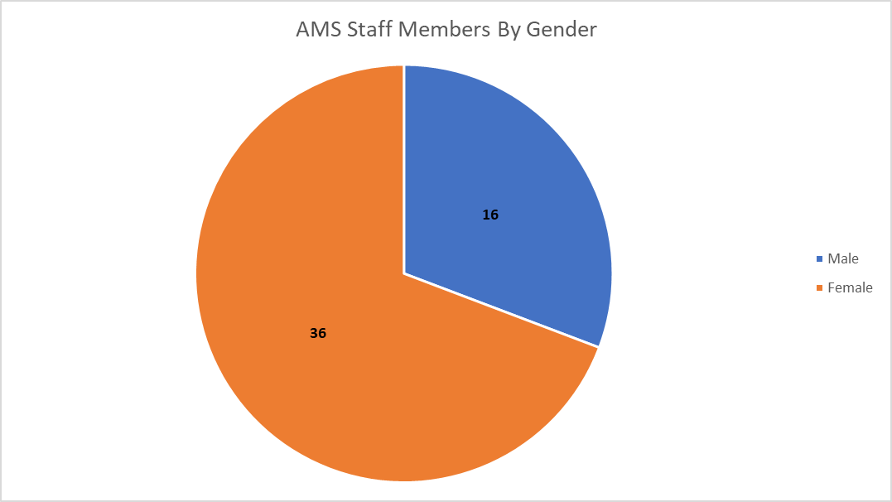
Adairsville staff demographics by gender
N = 52

Slide 5
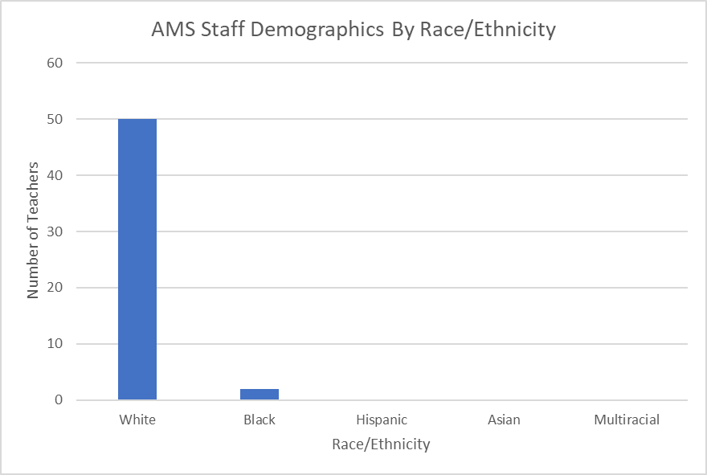
Adairsville Staff Demographics by race/ethnicity
N = 52

Slide 6
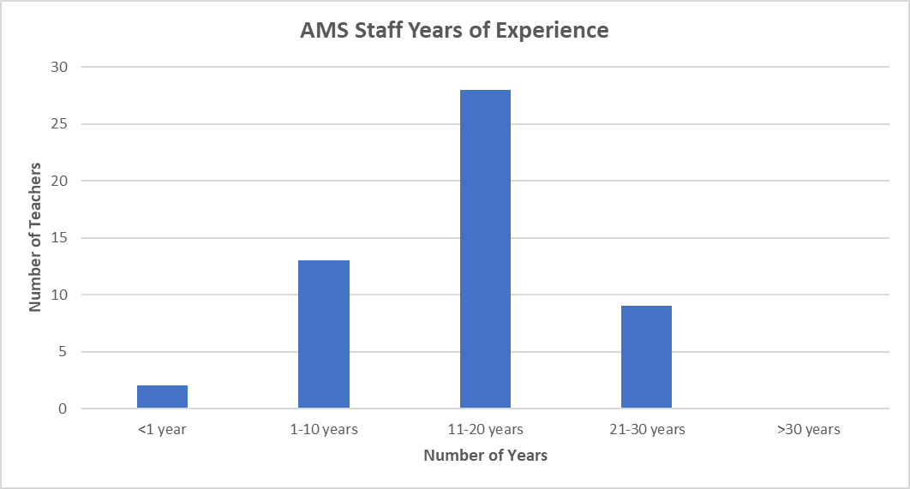
Adairsville Staff years of experience
N = 52

Slide 7
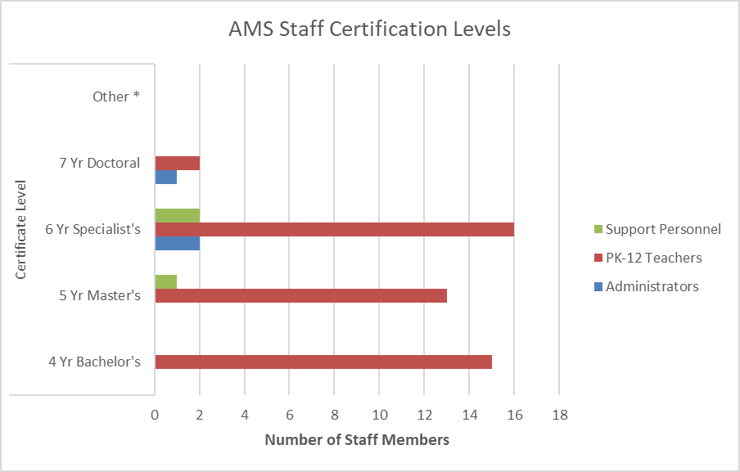
Adairsville staff certification levels 2017-2018
N=52

Slide 8
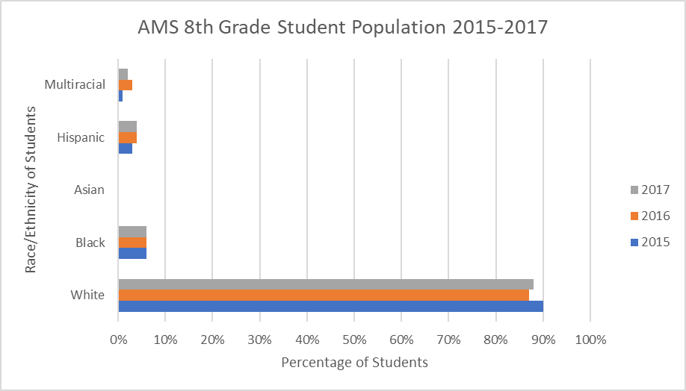
Adairsville 8th Grade Demographics by Race/Ethnicity
2015: (N=221) 2016: (N=235) 2017: (N=258)

Slide 9
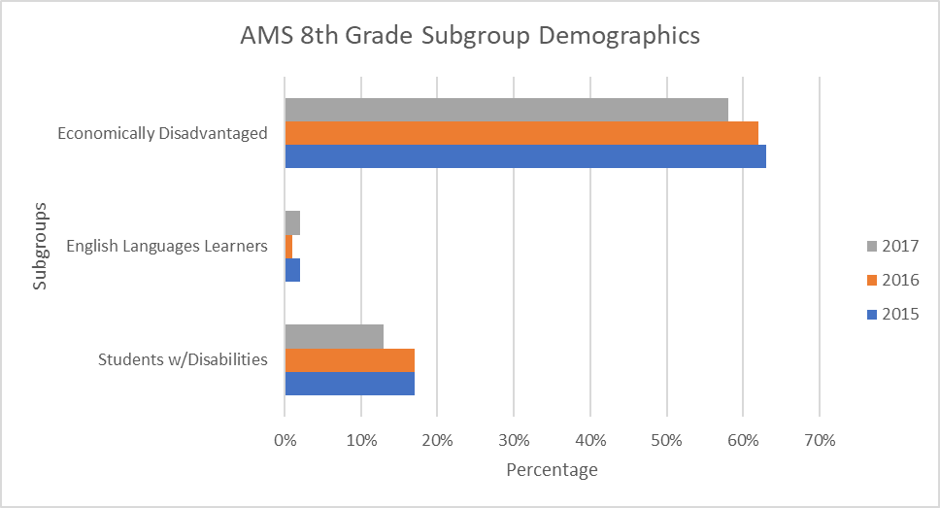
Adairsville 8th Grade Subgroup Demographics
2015: (N=221) 2016: (N=235) 2017: (N=258)

Slide 10
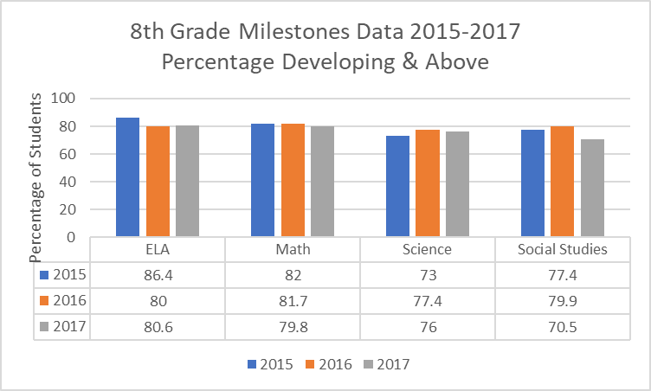
AMS 8th grade Milestones data 2015 – 2017 Percentage Passed
2015: (N=221) 2016: (N=235) 2017: (N=258)
Weakness: Science & SS Strength: ELA & Math

Slide 11
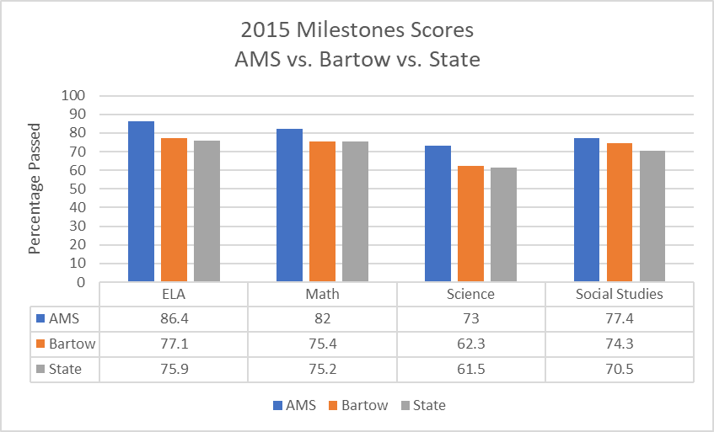
2015 8th Grade Milestones Scores AMS vs. Bartow vs. state

Slide 12
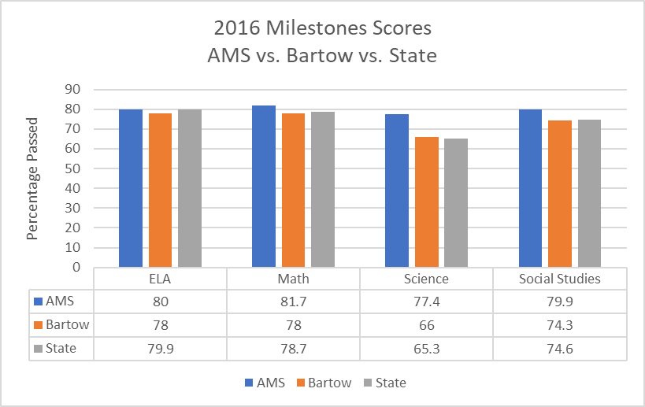
2016 8th Grade milestones Scores AMS vs. Bartow vs. state

Slide 13
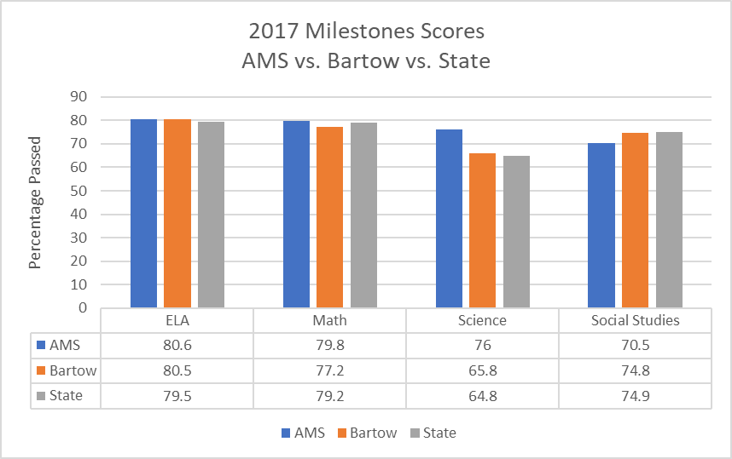
2017 8th Grade Milestones Scores AMS vs. Bartow vs. state

Slide 14
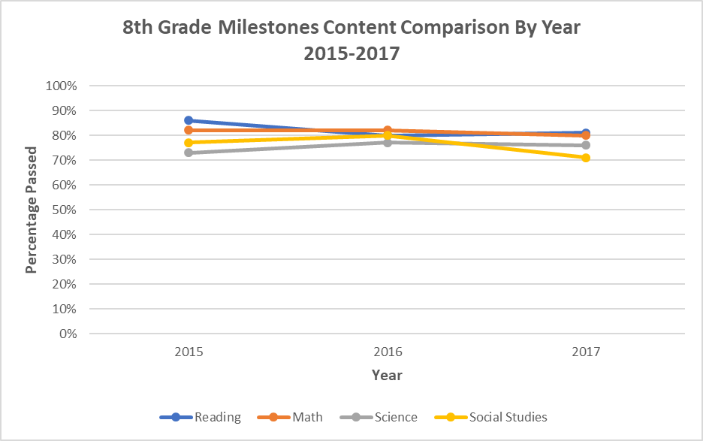
AMS 8th Grade Milestones content area comparison 2015 – 2017
2015: (n=221) 2016: (n=235) 2017: (n=258)

Slide 15
Discussion
Based on these results, it is clear that Social Studies is the weakest subject of 8th graders at AMS. Why?
Based on these results, it is clear that Math & Reading are consistently the strongest subjects of 8th graders at AMS. Why?
2015: (N=221) 2016: (N=235) 2017: (N=258)

Slide 16
Discussion Continued
What can we do to improve our Social Studies results in 8th grade?
Is our curriculum aligned?
Do we have adequate resources?
Are we providing meaningful learning experiences for our students?
Why was there such a drop in scores from 2016 to 2017?
2015: (N=221) 2016: (n=235) 2017: (n=258)

Slide 17
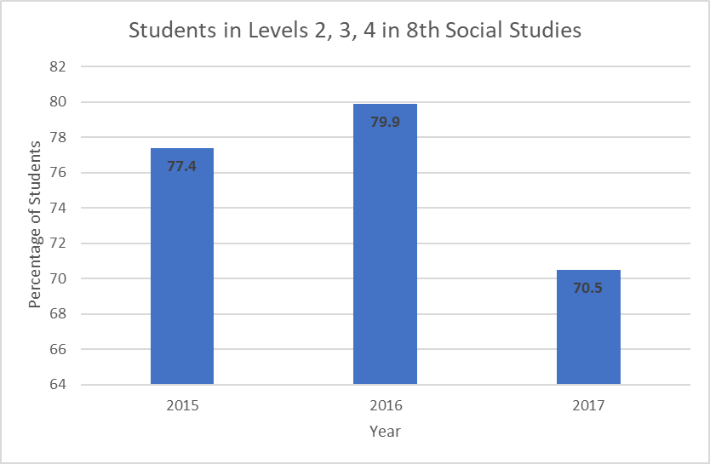
Adairsville 8th Grade Social studies milestones results 2015 - 2017
2015: (N=221) 2016: (N=235) 2017: (N=258)

Slide 18
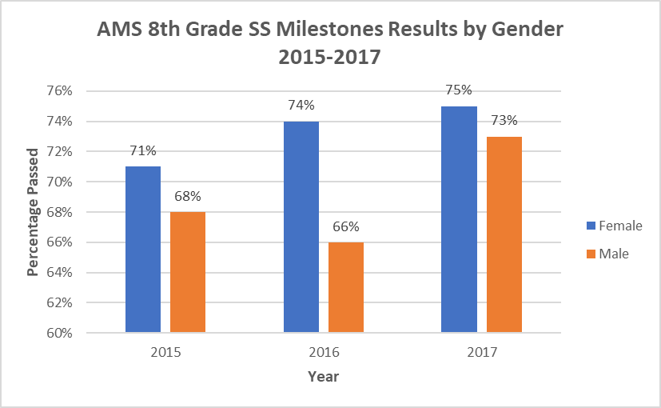
AMS 8th grade social studies milestones results 2015-2017 by gender
Male: 2015: (n=116) 2016: (n=119) 2017: (n=134)
Female: 2015: (n=105) 2016: (n=116) 2017: (n=124)

Slide 19
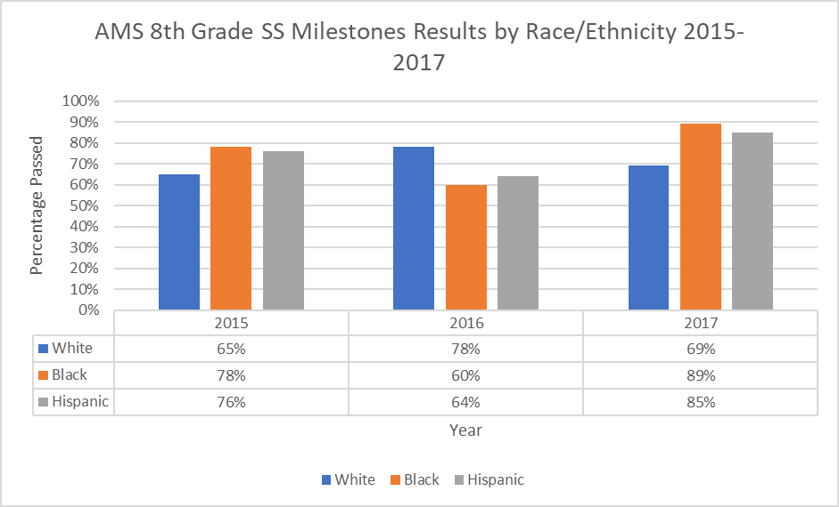
AMS 8th grade social studies milestones results 2015-2017 by race/ethnicity
2015: (N=221) 2016: (N=235) 2017: (N=258)
White (n = 201) White (n = 209) White (n = 229)
Black (n = 11) Black (n = 14) Black (n = 16)
Hispanic (n = 9) Hispanic (n = 12) Hispanic (n = 13)

Slide 20
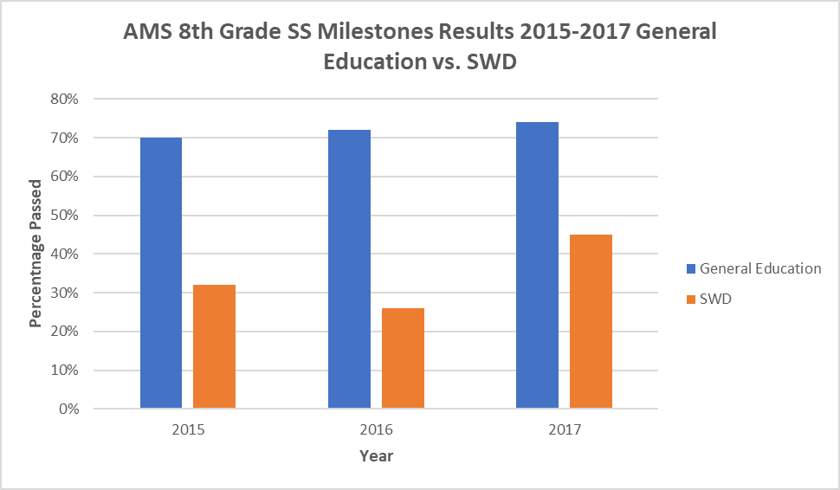
Adairsville 8th grade science CRCT results General education vs. SWD 2012-2014
Gen. Education: 2015: (n=189) 2016: (n=199) 2017: (n=216)
SWD: 2015: (n=32) 2016: (n=36) 2017: (n=42)

Slide 21
Discussion: Let’s dig into the data
Strengths
Social studies scores are usually above the county and state averages.
Students with disabilities made gains from 2015 – 2017. What changed? What can we continue to do?
Black & Hispanic students continue to outperform the White students.
Weaknesses
Students with disabilities, while growing, are still underperforming.
Social Studies scores fell significantly in 2017. Why?
Females have consistently outperformed males in Social Studies.

Slide 22
The big Question
ELA and Math continue to be major strengths in 8th grade. We have continued to perform equally as well as the state or above the state average while Social Studies continues to be our weakness.
What is happening in ELA and Math that is not happening in Social Studies (and Science)?

